Slide 1
PROJECT 1
ROADSAFETY ANALYSIS between 2010 and 2016

Slide 2
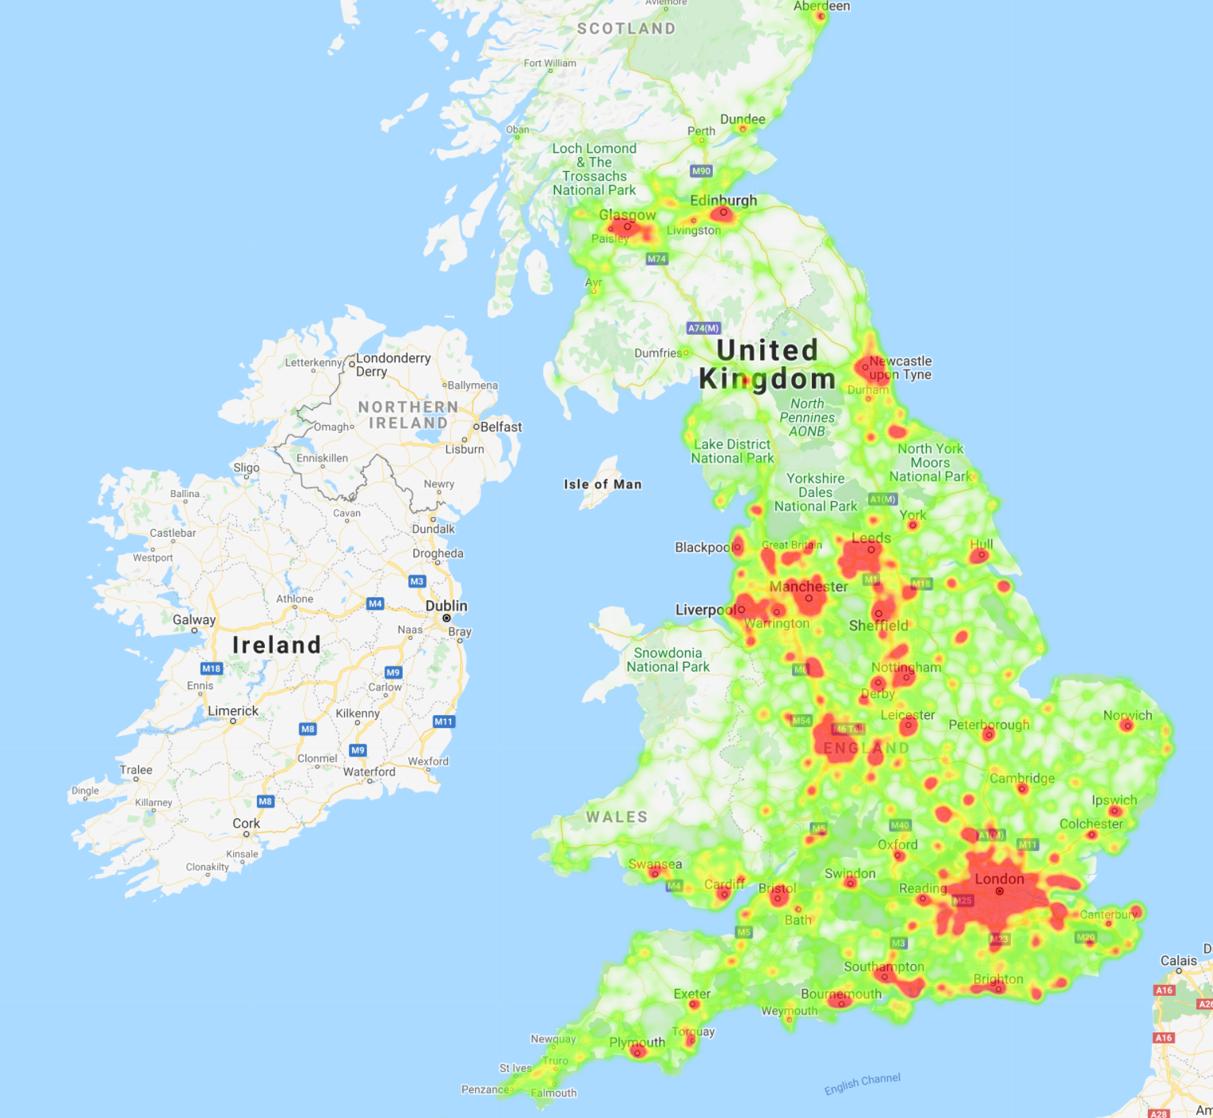
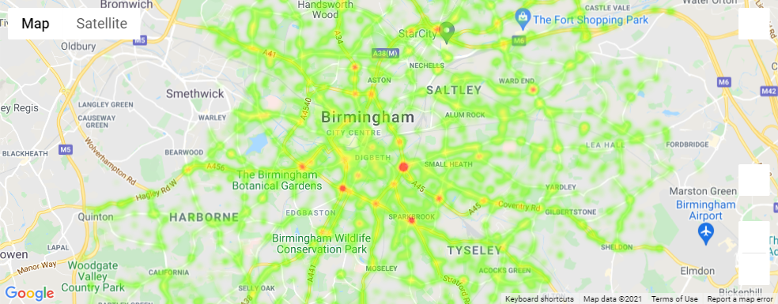
Heatmaps to demonstrate locations of accidents occurred between 2010 and 2016 in the UK and Birmingham

Slide 3
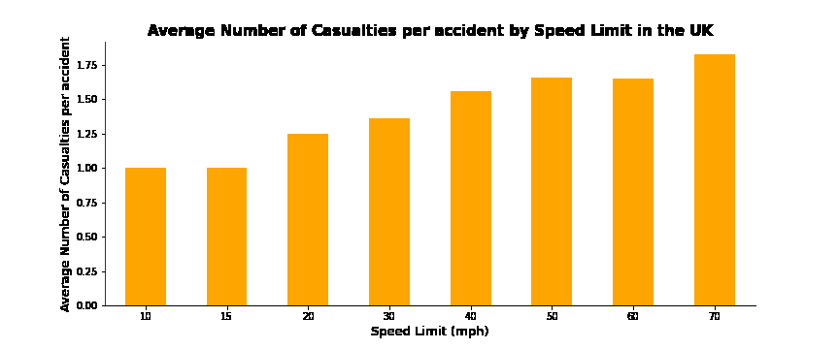
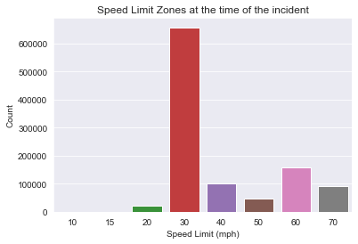
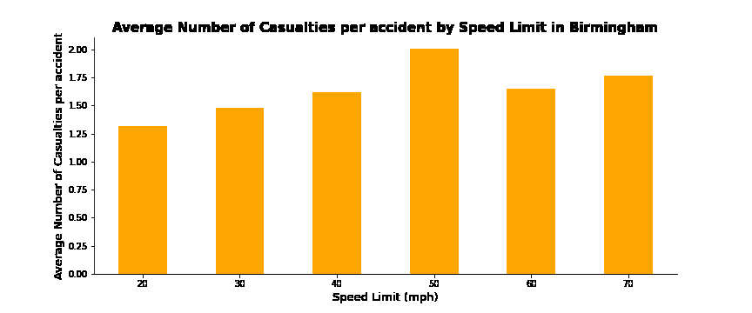
Number of accidents against the speed limit zones and Charts presenting the number of casualties per accidents against the speed limit zones

Slide 4
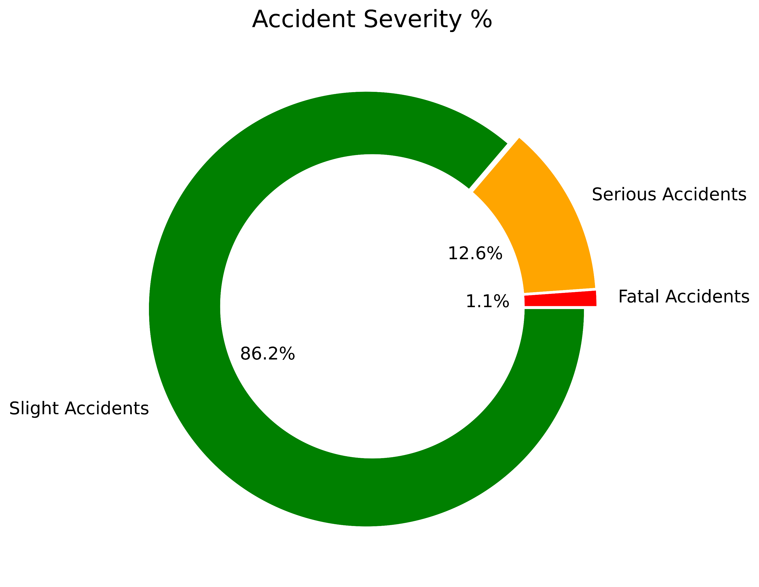
Distribution of accident percentage by severity

Slide 5
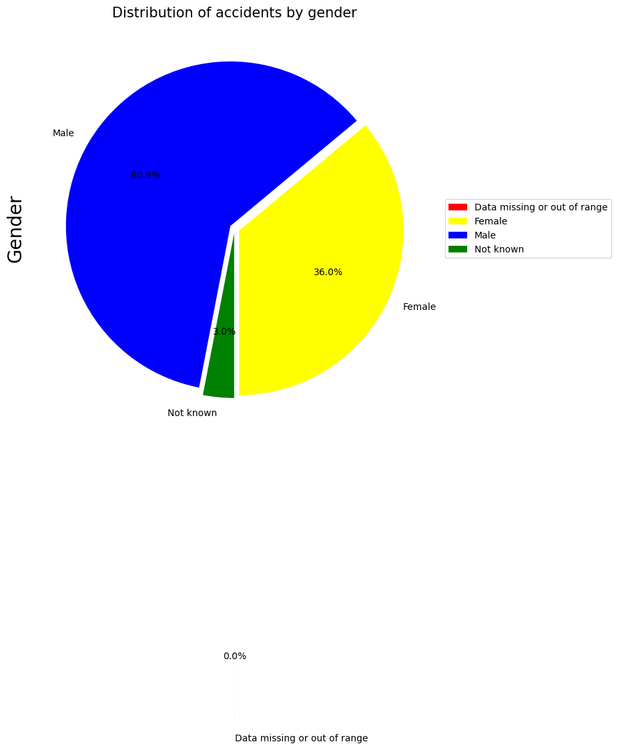
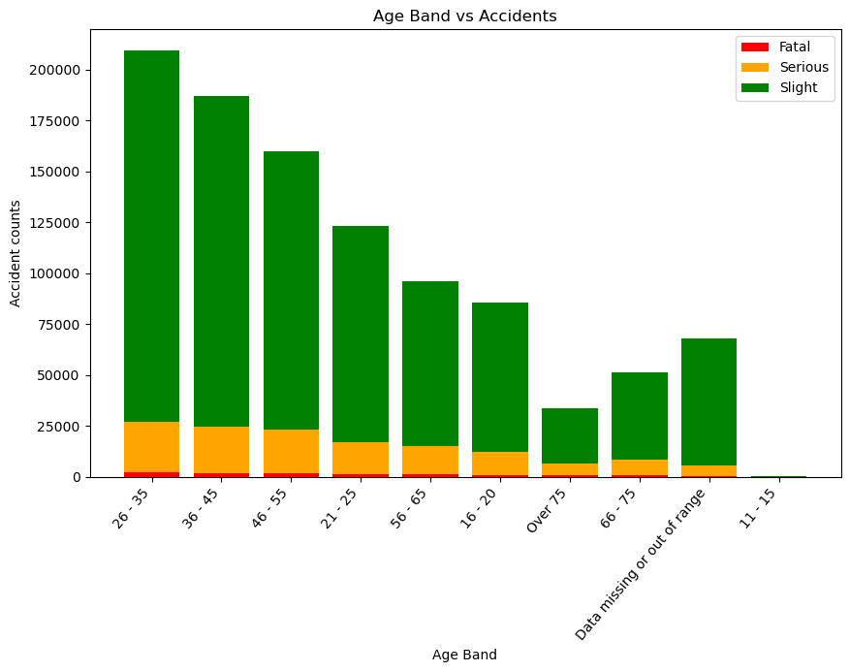
Distribution of accidents by gender and age bands

Slide 6
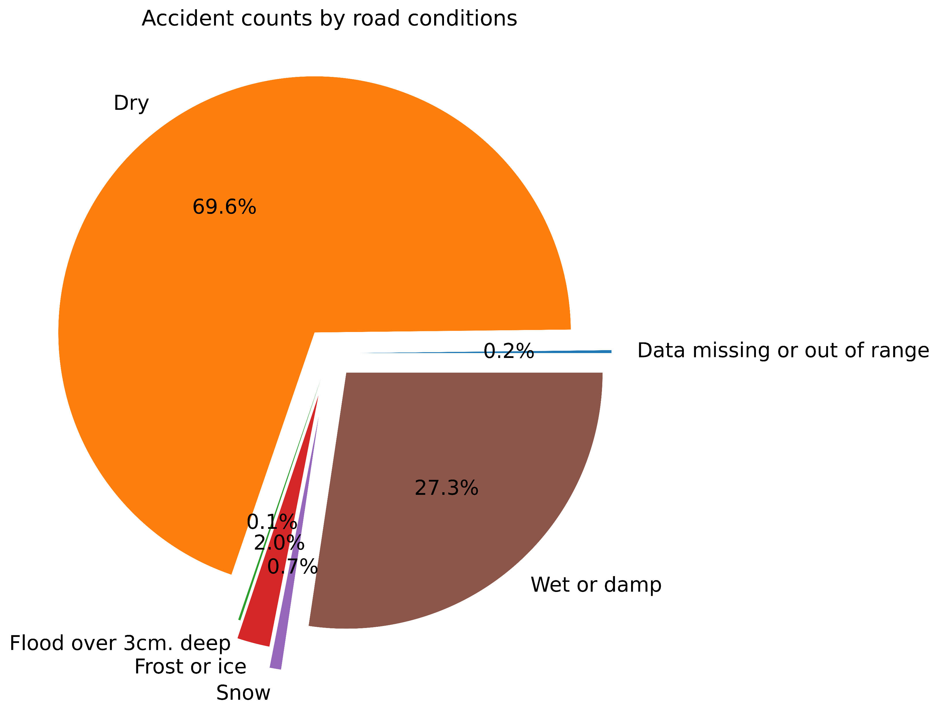
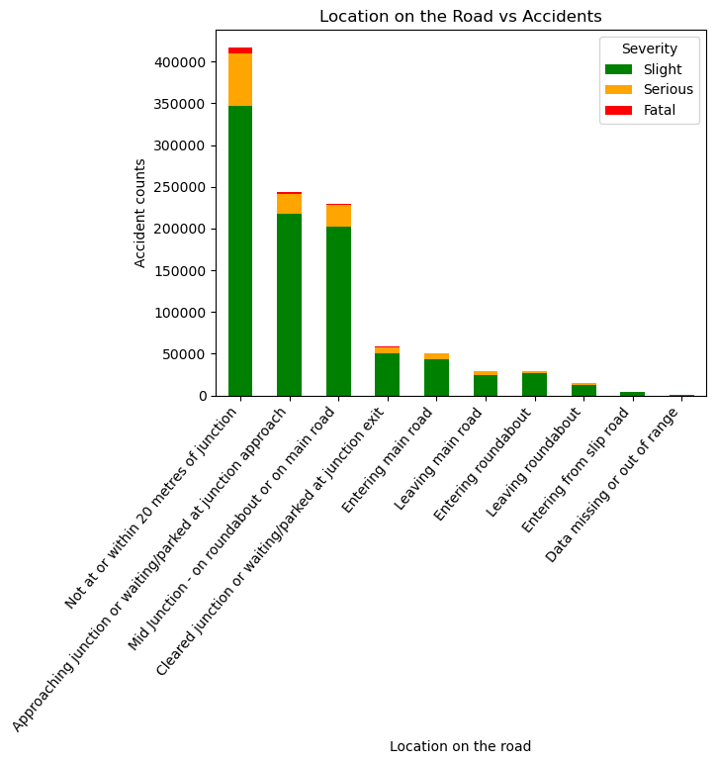
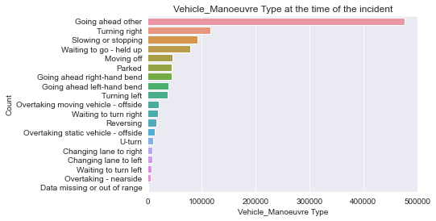
Demonstration of accident counts by road conditions, location on the road and vehicle manoeuvring at the time of the incidents

Slide 7
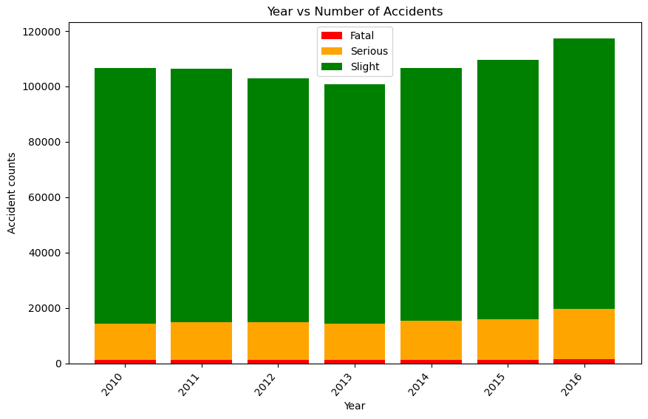
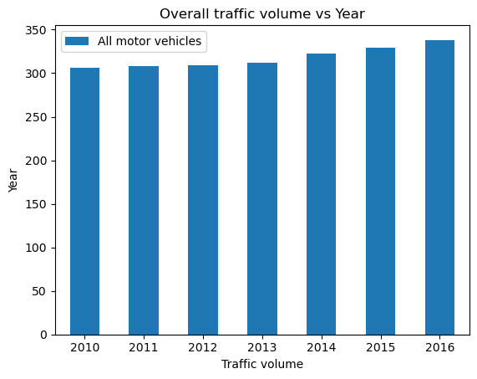
Comparison of the number of accidents recorded between 2010 and 2016 and the overall traffic recorded during this period

Slide 8
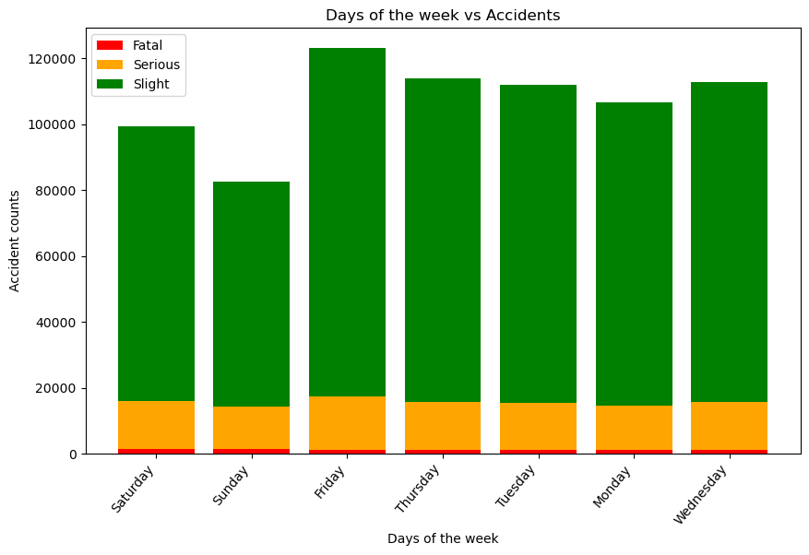
Number of accidents by severity recorded during the week

Slide 9
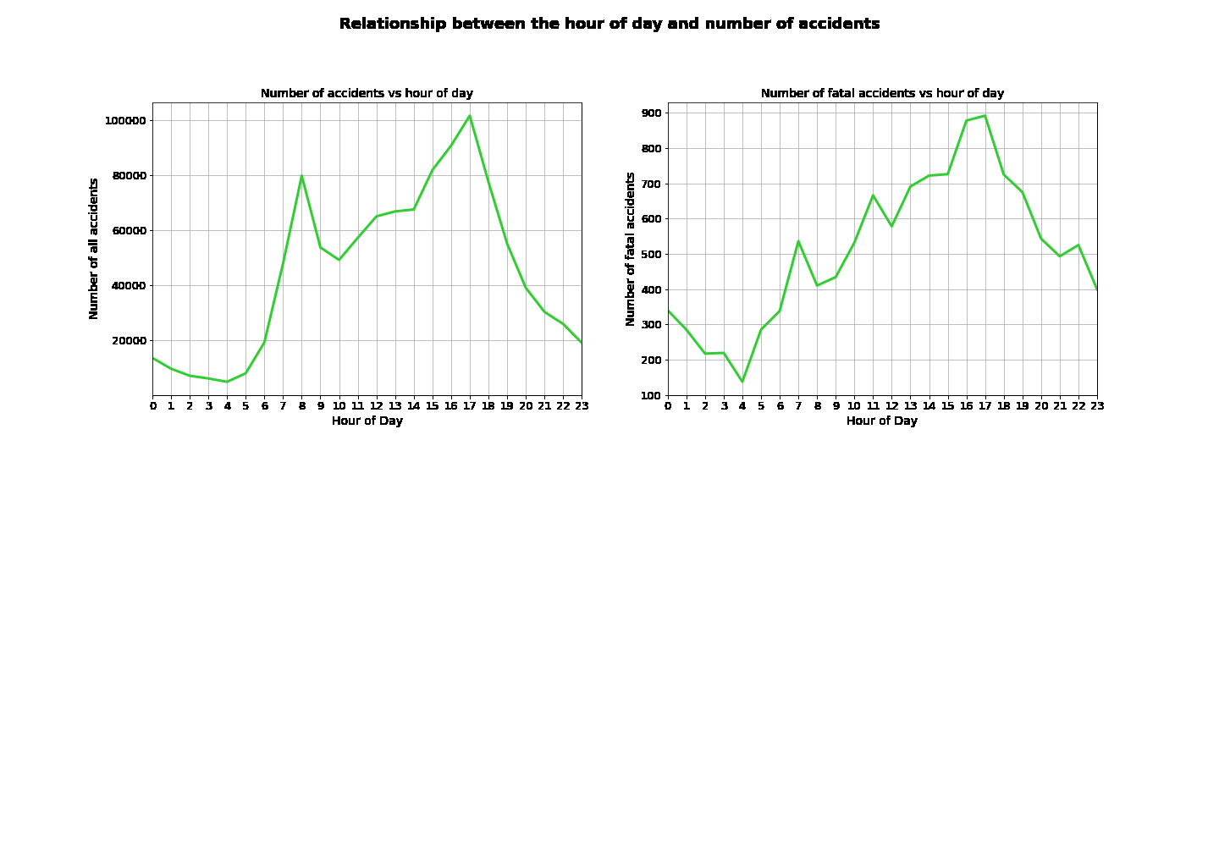
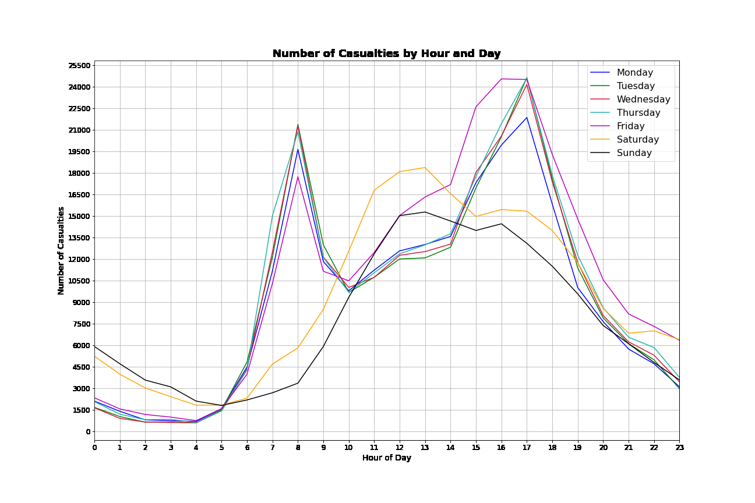
Comparison of number of accidents and fatal accidents by hours of the day

